Slide 1
The George W. Woodruff School of Mechanical Engineering at Georgia Tech
What is ME?
What jobs can I do as an ME?

Slide 2
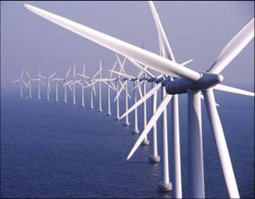
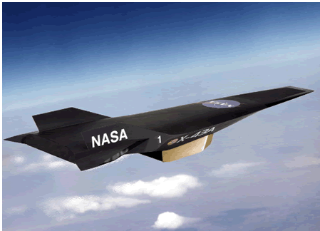
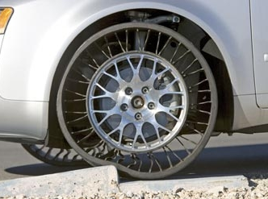
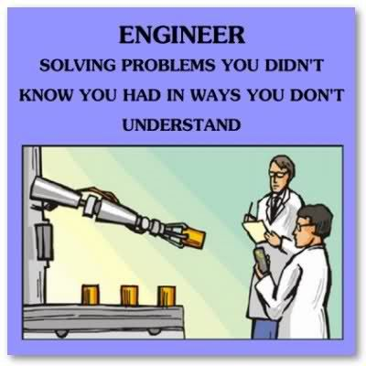
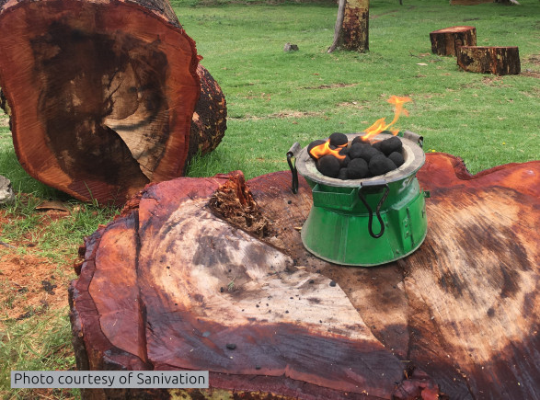
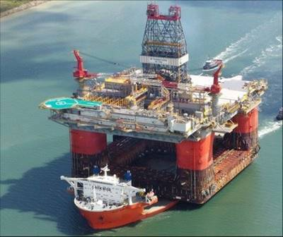
Mechanical Engineering Is…
“Scientists discover the world that exists; engineers create the world that never was.”
-Theodore Von Karman
Finding creative solutions to problems!
Perhaps the broadest of all the engineering disciplines.
Working with motion, energy, forces, and heat.
Concerned with analysis, design, manufacture and operation of:
Energy
Defense & Aerospace
Manufacturing
Environment
Health & Bio
Transportation

Slide 3
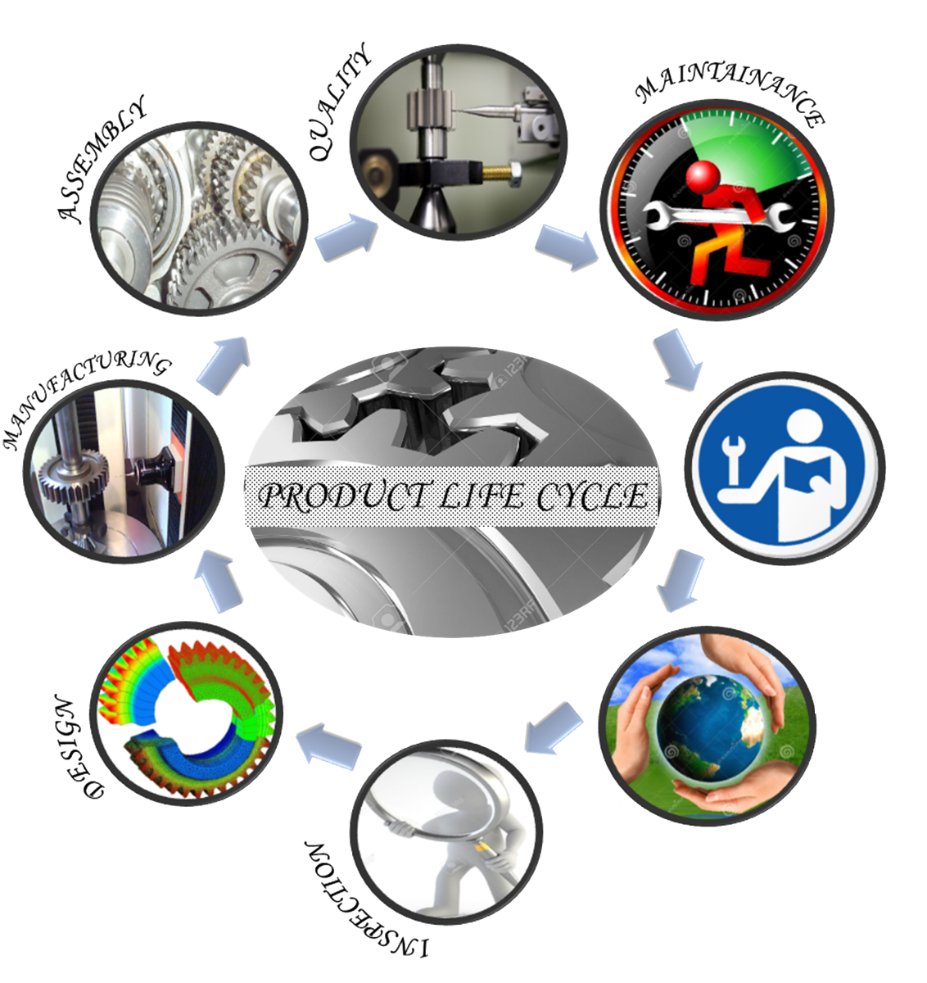
ME: Ideas to Reality
Fabrication
Testing
Examples of Design
Machines that manufacture and package all varieties of products
Sports equipment
Consumer products (napkins to roller coasters)
Automation - conveyors, robots, production lines
Cars, trucks, heavy equipment, buses, aircraft, ships
Construction equip.
Oil well drilling and extraction equipment
Electronics
Nearly every man made object has been worked on by a Mechanical Eng.
Equipment Design
Automation & Robotics
Transportation
Logistics
Supply Chain
Lean 6 Sigma
Continuous Improvement
Field Engr.
Technical Sales
SERVICING
Raw Material Extraction
Project Management
Business Analysis
Ideation
Analysis (FEA, CAD)
Prototyping (3D printing)
Validation
Systems Engineering
Patent Law
END OF LIFE
Reuse
Recycling
Disposal
Sustainability
Research & Development

Slide 4
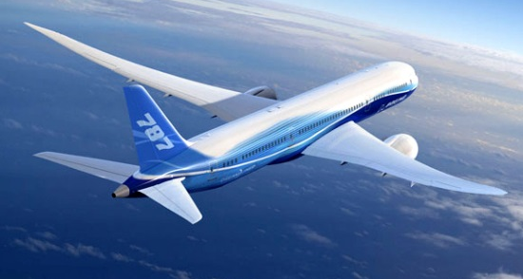
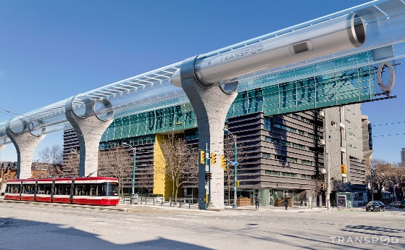
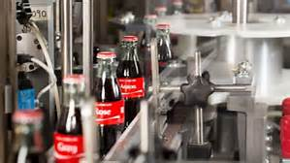
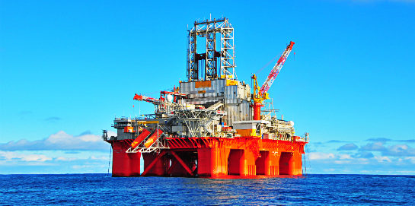
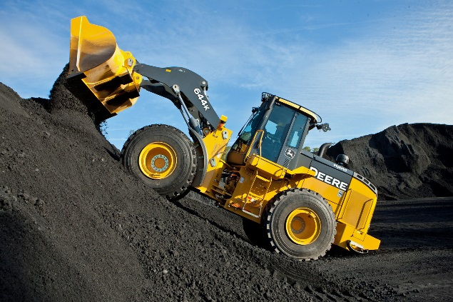
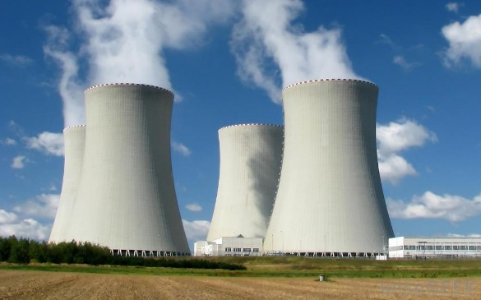
What Industries Hire ME’s?
Aerospace & Defense
Automotive, Rail, Ships, etc
Food & Beverage
Renewable Energy
Oil & Gas
Consulting
Toy Design & Manufacturing
Construction & Equipment
Automation & Robotics
Power Generation
Biomedical
And many more…
HVAC & Refrigeration
Electronics, telecom
Consumer products
Chemical, pharmaceutical
National laboratories
Military

Slide 5
Our Recent Graduates Are At:
Automotive
Ford, GM, Toyota, BMW, KIA, Honda, Mercedes, Bosch, Michelin, Tesla, Porsche,
Energy, Oil & Gas
BP, Citgo, Baker Hughes, Schlumberger, Georgia Power, Southern Company, General Electric, Shell, Suez Energy, Chevron, Scana, Westinghouse, Atlanta Gas & Light, Exxon-Mobil, Conoco, Apache, Phillips 66, Bechtel, Baker Hughes
Commercial & Consumer Products
Cooper Lighting, General Mills, Clorox, Frito Lay, Mattel, Coke, International Paper, Lexmark, Proctor & Gamble, Snap-On, 3M, National Instruments, Texas Instruments, Kimberly Clark, Kids II, Apple, Southwire, Colgate, Russell Athletic, Steelcase, Georgia Pacific, AGCO
Transportation & Construction
John Deere, Caterpillar, Kubota Tractor Corporation, Norfolk Southern, CSX, Parsons, Club Car, EZ Go
Aerospace & Defense
NASA, Bell Helicopter, Lockheed Martin, Gulfstream Aerospace Corp, Rolls Royce, Northrop Grumman, Harris Corp, Boeing, NAVSEA, Boeing, Advanced Armament Corp, NAVAIR, Pratt & Whitney, SpaceX, L3 Technologies
Business
Ernst & Young, Bank of America, CarMax, Deloitte, Capital One, Accenture, Pinnacle
Automation and Robotics
Innotec Automation, Rockwell Automation, IPA, Advanced Automation, Factory Automation
Engineering Services & Consulting:
Dean Oliver International, CH2M, Patterson & Dewar, McKenney's Mech. Contractors, Jordan & Skala, Accenture, Babcock & Wilcox, Turner Construction, Slingshot, Pinnacle, Deloitte
HVAC
Trane, Underwood Air Systems, Carrier
Chemicals
Air Products, Air Liquide, Dow Chemical, Eastman Chemical Company
Medical & Pharmaceutical
Medtronic, GE Healthcare, Abbott Labs, CibaVision, Eli Lily, Johnson & Johnson
Military & Government
Air Force, Navy, Marines, Army, CIA, FBI

Slide 6
ME Full-Time Hiring (2015-2018)
Top 12 Employers
General Motors (GM)
Boeing
Accenture
Eaton Corporation
ExxonMobil
Shell Oil Company
SpaceX
Epic
Harris Corporation
Lockheed Martin
Newell Brands
General Electric (GE)
Additional Top 40 Employer Highlights
3M | Microsoft
Area-I (UAVs) | National Instruments
B&R Automation | Northrop Grumman
Caterpillar | P&G
Ford Motor Company | Phillips 66
Georgia Power | Pratt and Whitney
IBM | Pricewaterhouse Coopers
Insight Sourcing Group | Proficient Engineering, Inc.
Manhattan Associates | Tesla
McKenneys | Textron Specialized Vehicles
Michelin | The Clorox Company
Top States
GA | 45 %
CA | 7 %
TX | 6 %
FL | 5 %
MI | 5 %
SC | 3 %
LA | 3 %
NY | 3 %
NC | 2 %
AL | 2 %
MA | 2 %
VA | 2 %
WI | 2 %
Spring 2018 Salary Data: 75% of BSME students had job offers with a median salary of $70,000
Over 170 different companies have hired BSME students over the last 3 years

